Slide 1
Disinformation with AI
Group 4

Slide 2
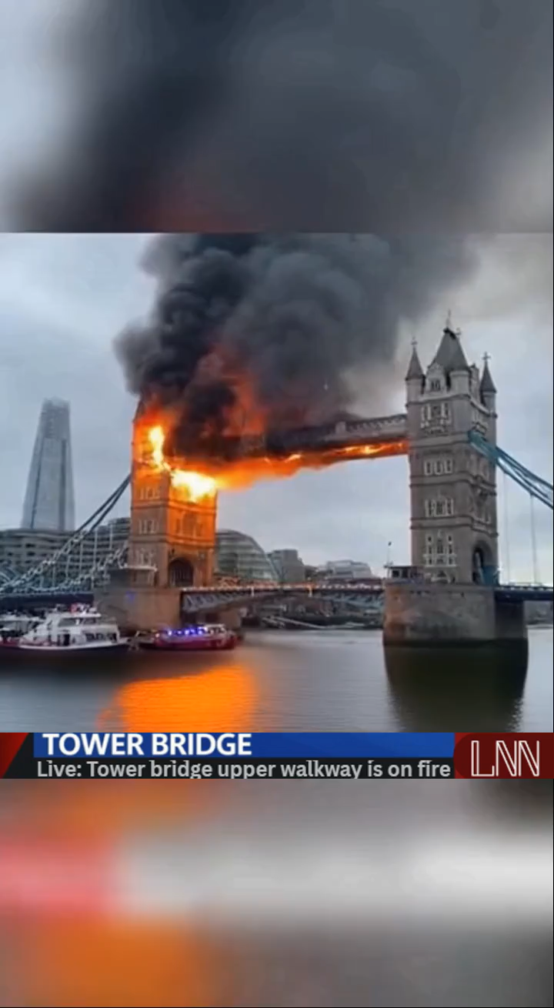

Slide 3
Impacts
In what ways does generative AI enable disinformation, and how can trust be protected?
People could become less trusting of news sources, leading to confusion about current events
People could use fake news to alter people's perception and change their opinions
AI is becoming widely available and more realistic

Slide 4
Goals
Our Goal was to create a realistic news report on a fake event, proving how easy Disinformation is to develop and how believable we can make it

Slide 5
Steps
Our methodology was simple.
We began with a prompt for OpenAI’s Sora 2 Model (codes widely available).
“fire on the London bridge”
We then iterated 5 times until we ended up with this prompt:
“Generate a 10 second news report about the Tower Bridge being on fire, making sure the video is in landscape and the overlay is not cut out”
Then because Sora2 had a watermark which showed the artefact was AI-generated, we simply searched up for a watermark removal tool to extract it. The second tool we found got the job done very well, with the exception of removing one of the overlays showing breaking news.
Then it was a simple job of adding that back in with a Canva’s image generator.

Slide 6
Conclusion?
The process of generating an AI video is extremely accessible to most online users.
This makes the likelihood of it being used in creating and spreading disinformation online extremely high, and in fact we’ve already seen such videos circulating social media.
Therefore it’s imperative that such tools are governed by regulatory oversight to prevent their misuse.

